Slide 1
Welcome to My presentation
Name : Sagor ray
ID :20191135010
Section : D

Slide 2
Introduction of transformer
What s transformer?
An A.C. device used to change high voltage low current A.C. into low voltage high current A.C. and vice-versa without changing the frequency.
In brief,
1.Transfers electric power from one circuit to another 2. It does so without a change of frequency 3. It accomplishes this by electromagnetic induction 4. Where the two electric circuits are in mutual inductive influence of each other.

Slide 3
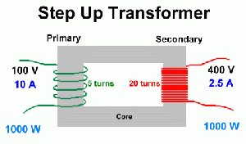
TYPES OF TRANSFORMER
STEP UP TRANSFORMER:
A transformer in which voltage across secondary is greater than primary voltage is called a step up transformer In this type of transformer, Number of turns in secondary coil is greater than that in Primary coil, so this creates greater voltage across secondary coil to get more output voltage than given through primary coil.

Slide 4
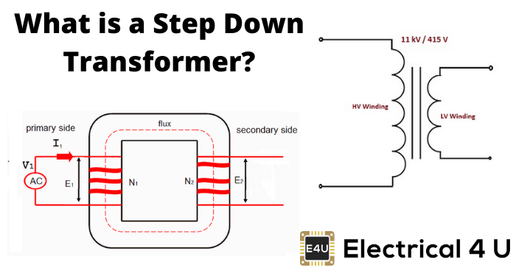
TYPES OF TRANSFORMER
STEP DOWN TRANSFORMER:
•A transformer in which voltage across secondary is lesser than primary voltage is called a step-down transformer •In this type of transformer, Number of turns in secondary coil is lesser than that in Primary coil, so this creates lesser voltage across secondary coil, so we get low output voltage than given through primary coil.

Slide 5
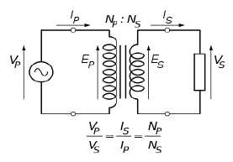
Ideal transformer
An ideal transformer is an imaginary transformer which has - no copper losses (no winding resistance) - no iron loss in core - no leakage flux In other words, an ideal transformer gives output power exactly equal to the input power. The efficiency of an idea transformer is 100%. Actually, it is impossible to have such a transformer in practice, but ideal transformer model makes problems easier.

Slide 6
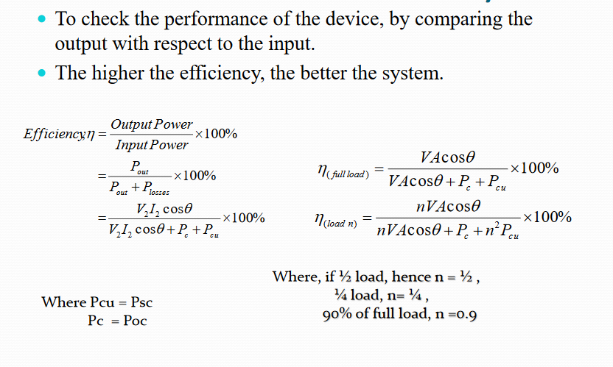
Transformer Efficiency

Slide 7
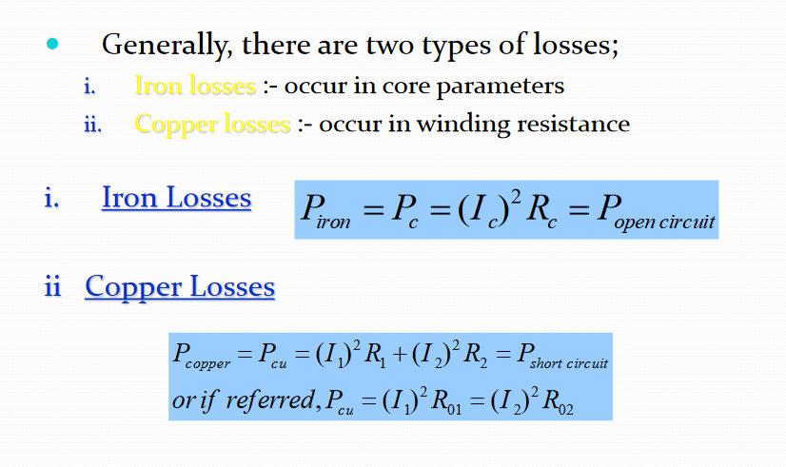
Transformer Losses

Slide 8
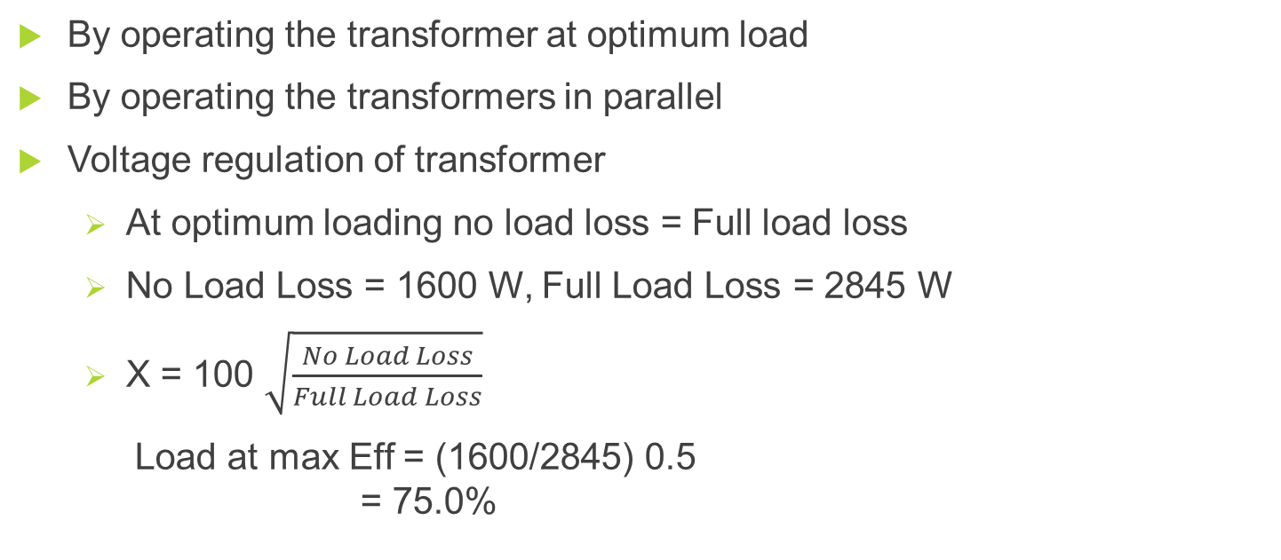
How to improve the efficiency of transformer
By operating the transformer at optimum load
By operating the transformers in parallel
Voltage regulation of transformer
At optimum loading no load loss = Full load loss
No Load Loss = 1600 W, Full Load Loss = 2845 W
X = 100 $\sqrt{\frac{No Load Loss}{Full Load Loss}}$
Load at max Eff = (1600/2845) 0.5 = 75.0%

Slide 9
E.M.F equation of a transformer
N₁ = No. of turns in primary N₂ = No. of turns in secondary Φm= Maximum flux in core in webers= B_{m} × A f = Frequency of a.c. input in Hz
If flux Φ varies sinusoidally, then r.m.s. value of induced e.m.f. is obtained by multiplying the average value with form factor.
Form factor = r.m.s. value / average value

Slide 10
E.M.F equation of a transformer
The r.m.s value E1 of the primary e.m.f is E₁ = 4.44f N_{A} Ø_{max} = 4.44f N_{A} B_{m} A Similarly, r.m.s value of induced e.m.f in secondary is E₂ = 4.44f N_{B} Ø_{max} = 4.44fN_{B} B_{m} A In an ideal transformer on no load, V_{A} = E_{A} and V_{B} = E_{B} , where V_{B} is the terminal voltage

Slide 11
Problem
The maximum flux density in the core of a 250/3000-volts, 50-Hz single-phase transformer is 1.2 Wb/m². If the e.m.f. per turn is 8 volt, determine
(i) primary and secondary turns
(ii) area of the core.

Slide 12
Solution
(i) E₁ = N₁ × e.m.f. induced/turn N₁ = 250/8 = 32; N₂ = 3000/8 = 375
(ii) We may use E₂ = 4.44 f N₂ B_{m} A ∴ 3000 = 4.44 × 50 × 375 × 1.2 × A; A = 0.03m².

Slide 13
THANK YOU

